Slide 1



重庆机场3号航站楼
荣腾清洁管理解决方案
Eddy Tan
VP, novaCitynets
Head, VDC & FM Div

Slide 2





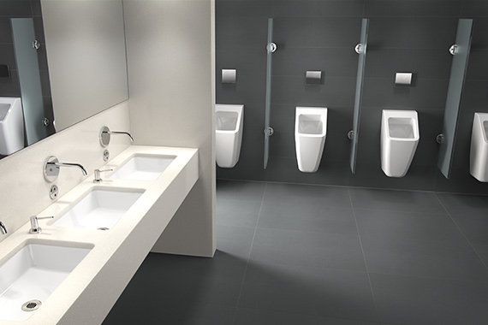
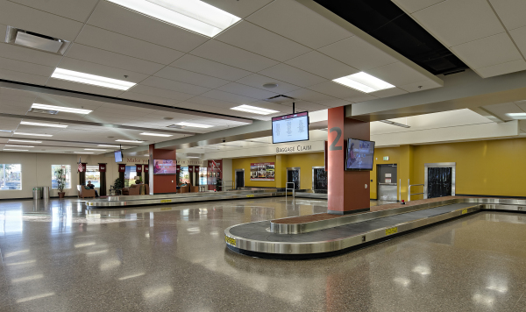


Increase Quality reduce effort
Cleaning on demand
Staff control – less staff
Report detail work progress for Airport
FaMe清洁工作负荷和质量管理模块
清洁工人
NFC
RFID
标签
工作报告
计划完成
FaMe用智能手机自动
工作审计与跟踪
报告时间和地点
监工
检查报告
计划完成

Slide 3

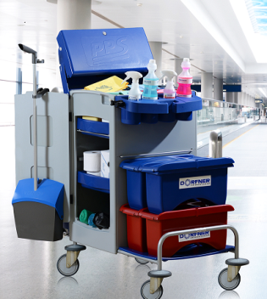




FaMe仓库管理模块
Detail list who use which cleaning suplliers for what purpose
Optimize cleaning supplies – less consumption protect environment
Right cleaning supplier protect inventory increase lifetime
仓库+设备管理
清洁团队
入
出
出

Slide 4
FaMe 员工管理与名单规划模块
名单规划
工作人员
团队 1
轮班 A
网格 A
团队 2
轮班 A
网格 B
团队1
轮班 B
网格A
Less staff for same task
Control work. What they do at which time. Complains linked to staff/team
Staff quality control / rating
Support security checks at airports. Which staff which acces which area at airport

Slide 5
FaMe清洁和质量管理模块
创建清洁目录
创建范围
创建清洁订单
创建清洁日期
创建KPI
KPI控制
5

Slide 6
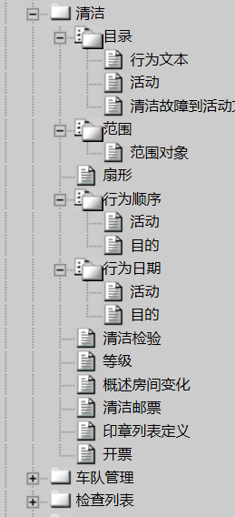
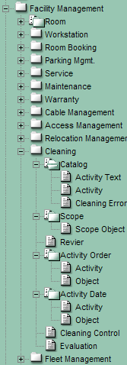
清洁功能
维护功能表
Catalog Tasks
Activity Text „to do“ Description
Complete Activity Text
Scope Link Objects and Activities
Objects Equipments
Section
Catalog Collection one or more
Cleaning Order
Activities Maintenance Contract
Objects Maintenance Contract
Cleaning Dates
Activities at Dates
Objects at Dates
6

Slide 7
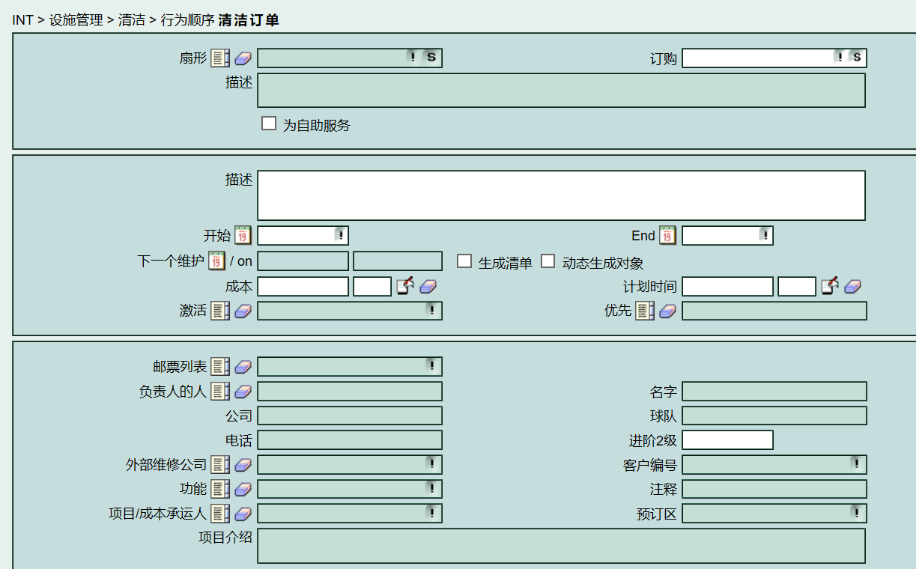
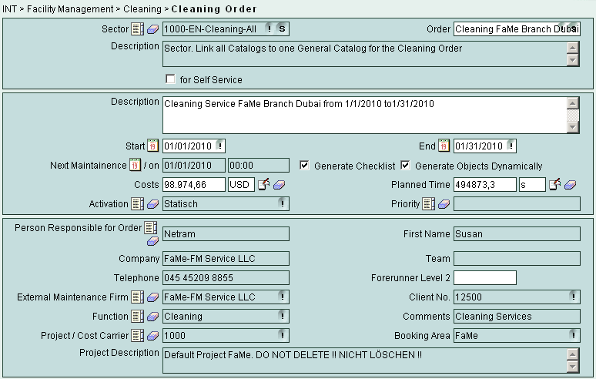

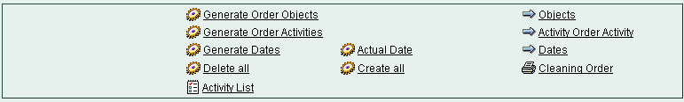
订购清洁 Order Cleaning
订购
部分
公司
7

Slide 8
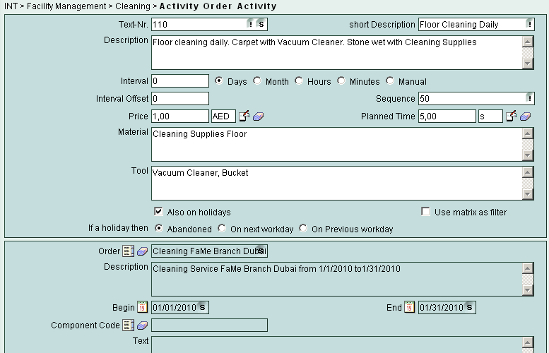
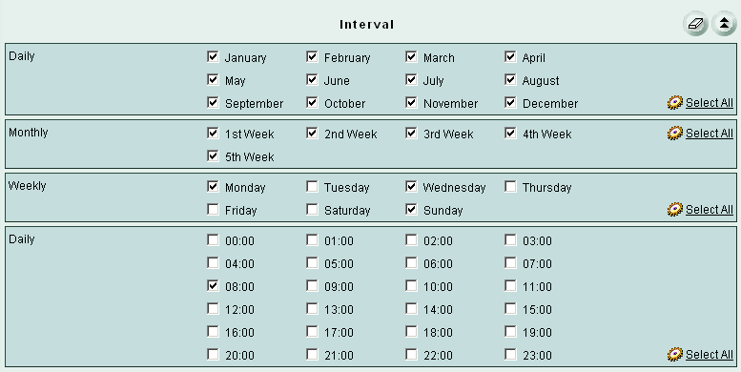
订购活动Order Activities
清洁间隔
8

Slide 9
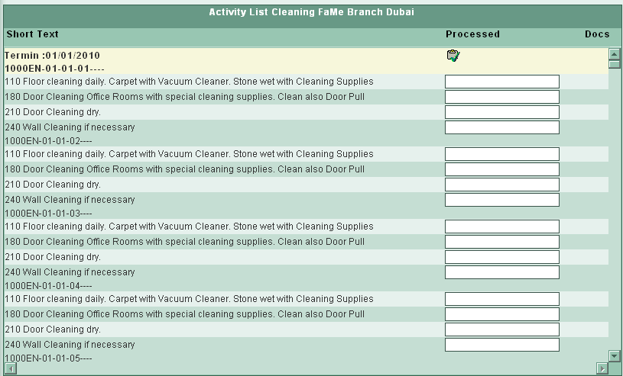
订单活动总概览
9

Slide 10
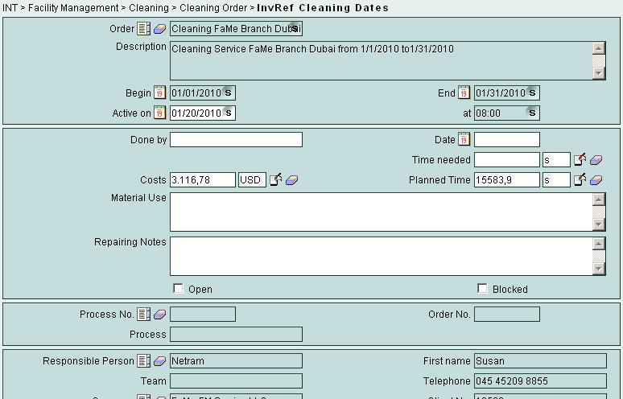
订购日期
10

Slide 11
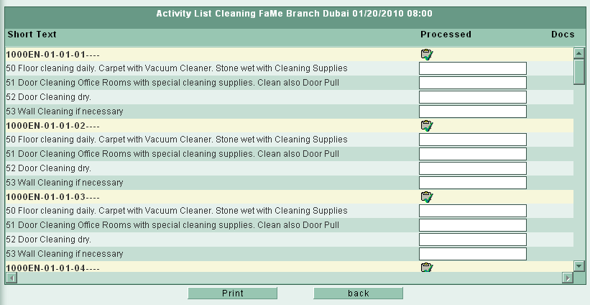
打印活动日期 Print Dates Activities
11

Slide 12
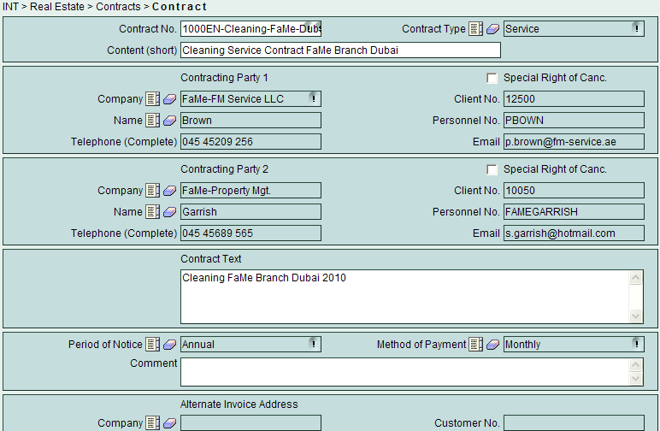
关键绩效指标(KPI)合约
12

Slide 13
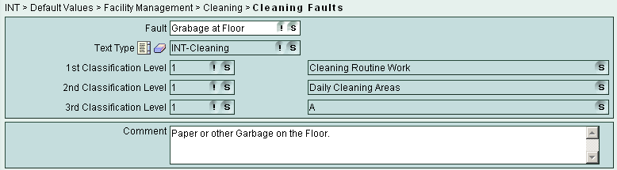
输入可能的清洁故障或问题
13

Slide 14
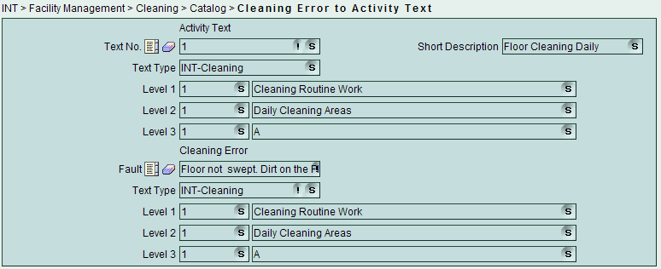
将故障链接到活动 Link Faults to Activity
Possible Cleaning Faults to Cleaning Task
14

Slide 15
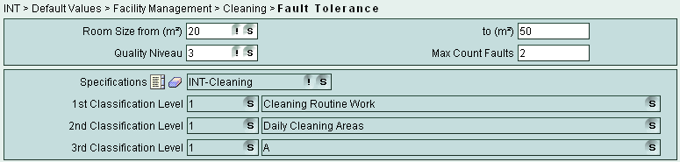
故障容忍度 Fault Tolerance
Fault tolerance in relationship to Room area and Quality Level
Default 3 Quality Levels
15

Slide 16

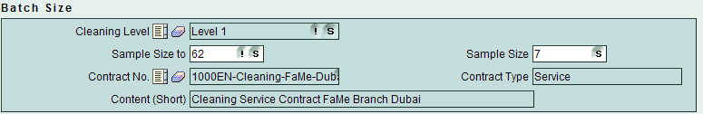
级别和批量大小 Levels and Batch Size
Cleaning Level 1 simply Level 2 normal Level 3 “stronger”
Sample Size to = numbers of Rooms
Sample Size = numbers of Rooms must be checked
16

Slide 17
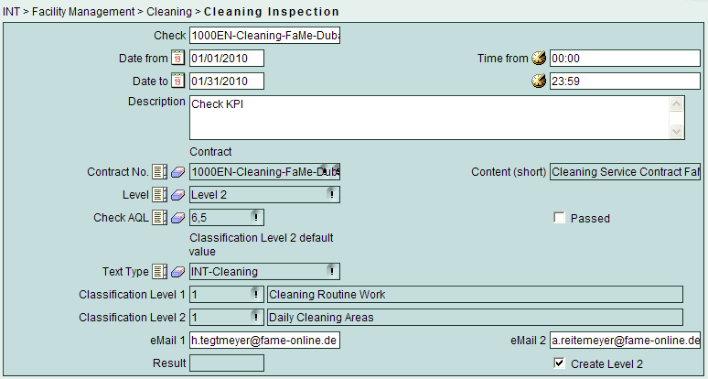
准备清洁质量
17

Slide 18
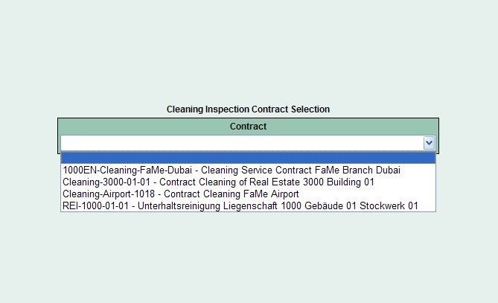
清洁质量检查
Login PARKER FAME28876
选择合同
18

Slide 19
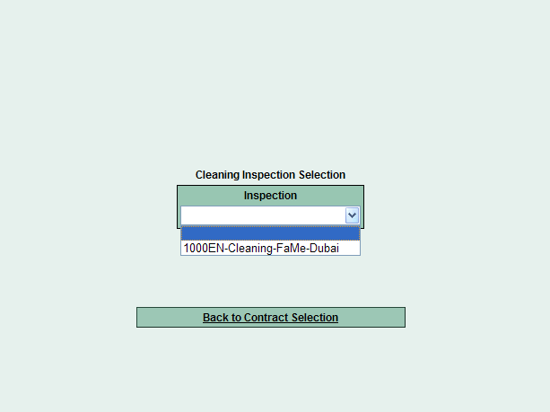
检查任务
Choose Inspection Task
19

Slide 20
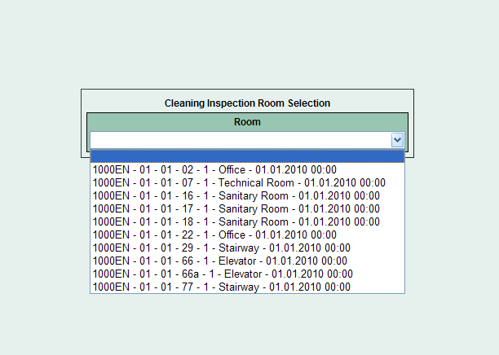
房间检查
Choose first Room
20

Slide 21
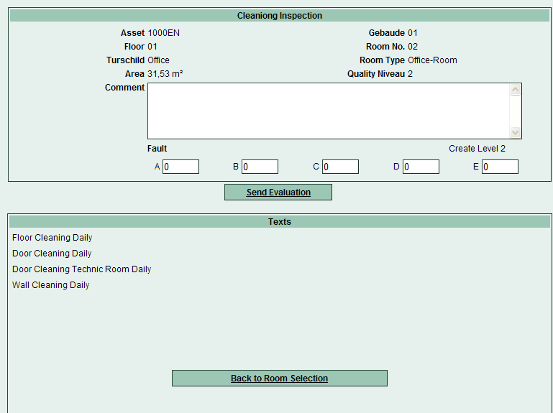
房间检查
房间概述
21

Slide 22
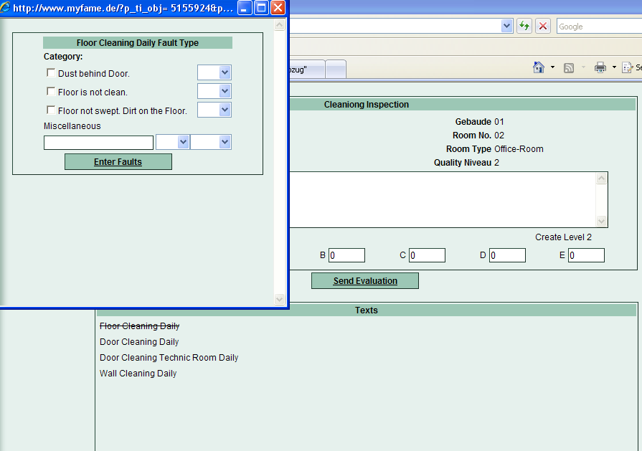
检查结果
22

Slide 23
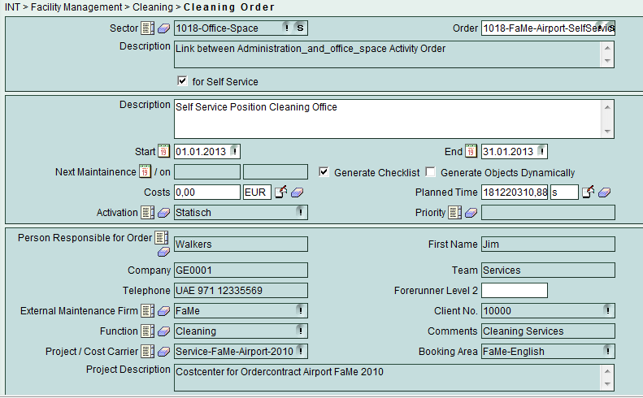
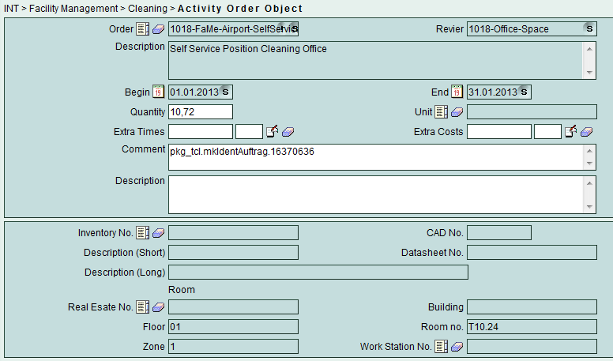
自助服务
23

Slide 24
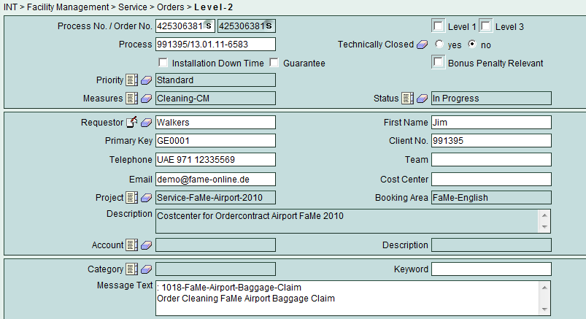
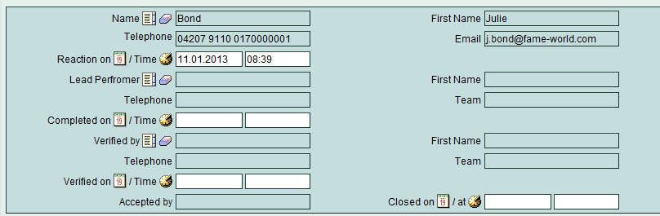
工作准备（二级）
Measure
Status
Supervisor (Project)
=BOND
Link to Shift
24

Slide 25
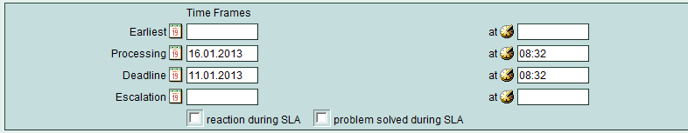
选项：KPI升级
25

Slide 26
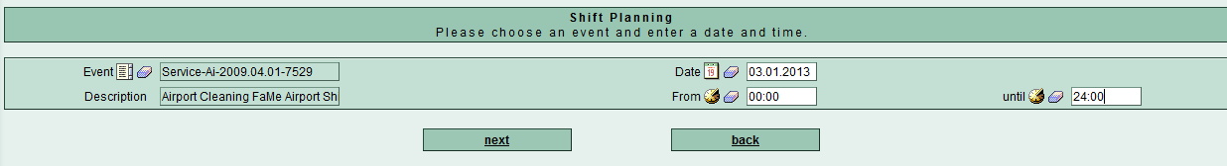
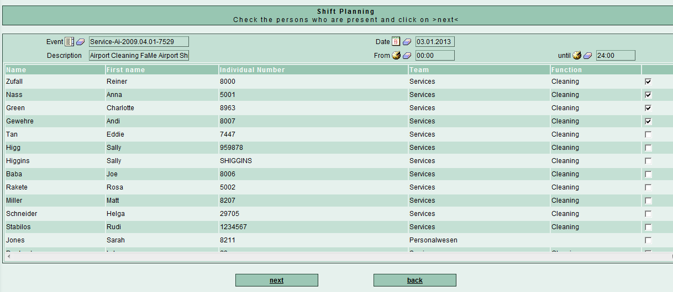
每日轮班规划
Login
BOND
Shift
Staff Shift
Available
Staff
26

Slide 27
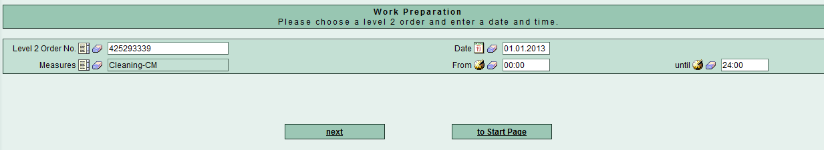
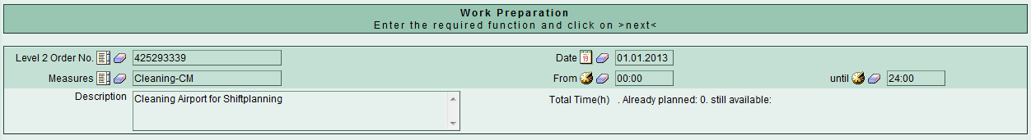
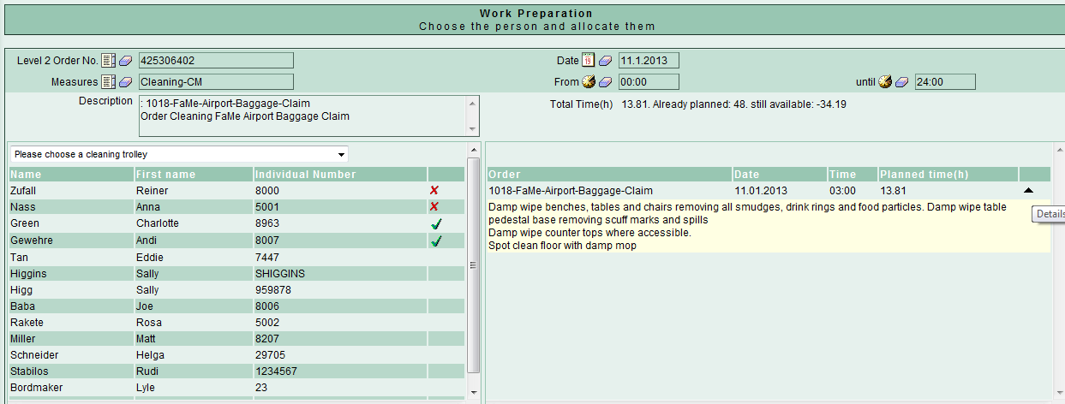
工作准备规划
Level2
Link
to Shift
Level2
Level2
Available
Staff
Level2 Task
Rooms
Time
设备发给员工
27
Notes:
27

Slide 28
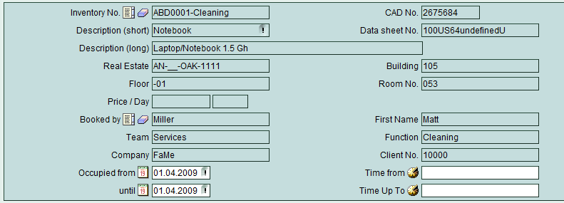
员工预订设备
(自动化)
Equipment
to
Staff
Date/Time
28

Slide 29
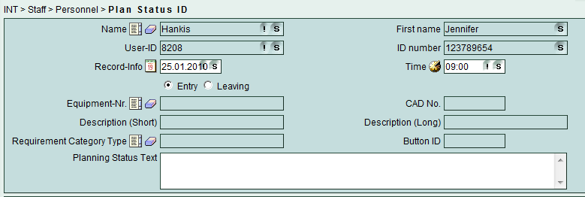
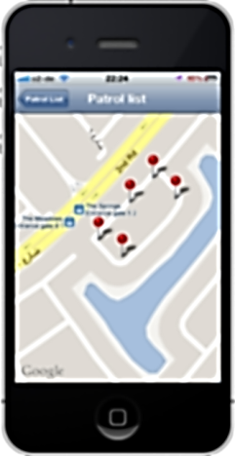
工作分析(员工时间）
员工
时间
设备/房间
控制点（选项）
29

Slide 30
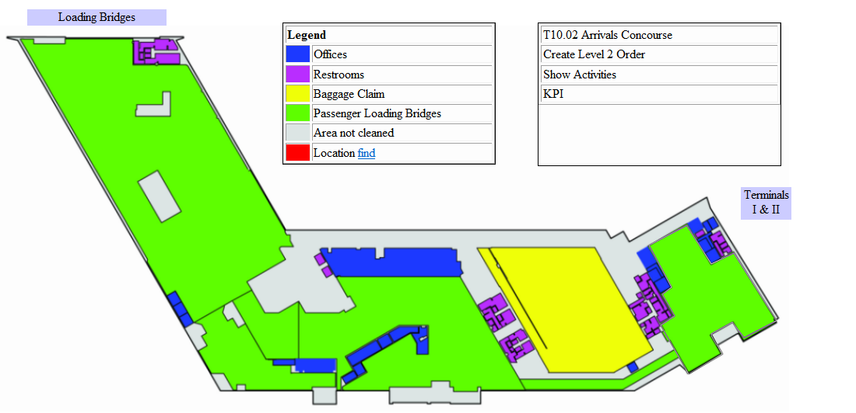
清洁区域

Slide 31
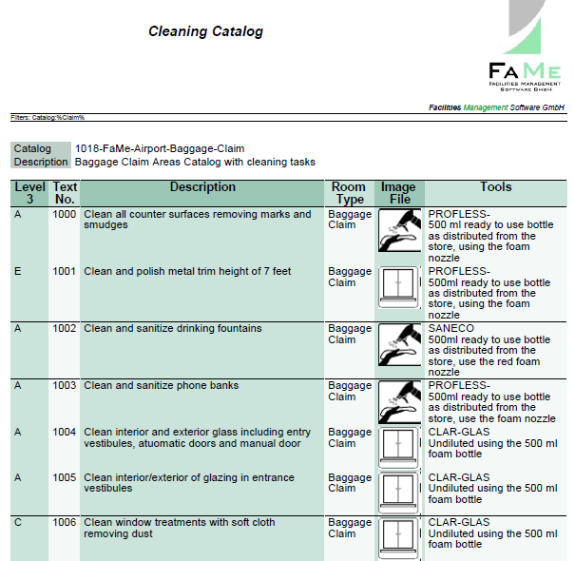
清洁目录报告
31

Slide 32
FaMe设备管理模块
设备/用品管理 Equipments/items Management
设备/零件进货，出货，手头 Equipments/Parts Incoming, Outgoing, on Hand
设备/零件订单 Equipments/Parts Order
级别2 的设备/部件请求 Equipments/Part Request by Level2
设备/部件管理级别2 Equipments/Parts Management Level2

Slide 33
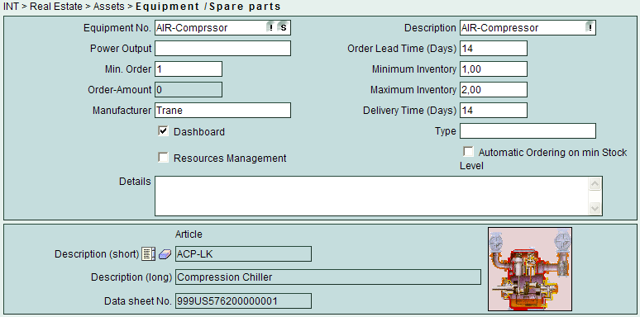
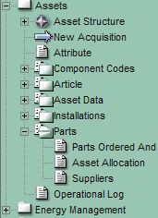
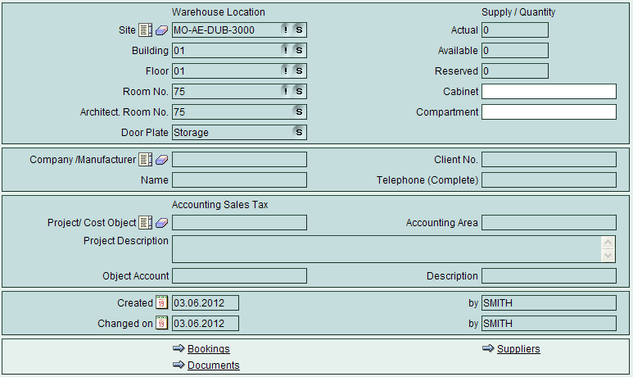
创建设备或清洁用品
Spare Part No.
Description
Order Time
Min. Number Storage
Max. Number Storage
Delivery Time
Flag automatically
ordering if min. number
on stock
Article
Store Location
Min. Order
Dashboard
Display
Tools In/Out
Tree
Manufacturer
Project / Cost Center
Reference Bookings
Supplier
Documents

Slide 34

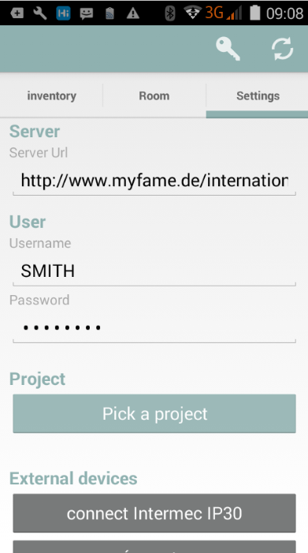
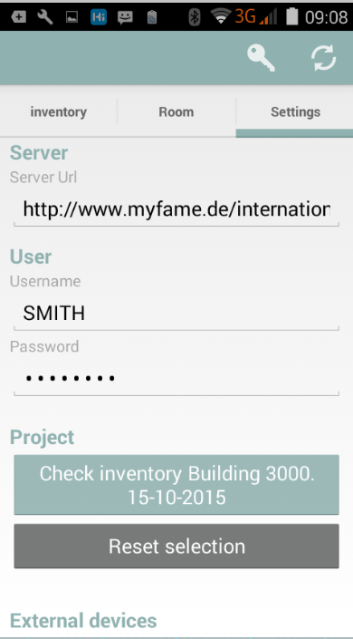
设备跟踪应用程序 - 库存APP
Login
Choose Folder Settings
Option: External Reading unit (RFID, Barcode 1/2D)
Choose project from picklist
App automatically switch to INVENTORY mode

Slide 35
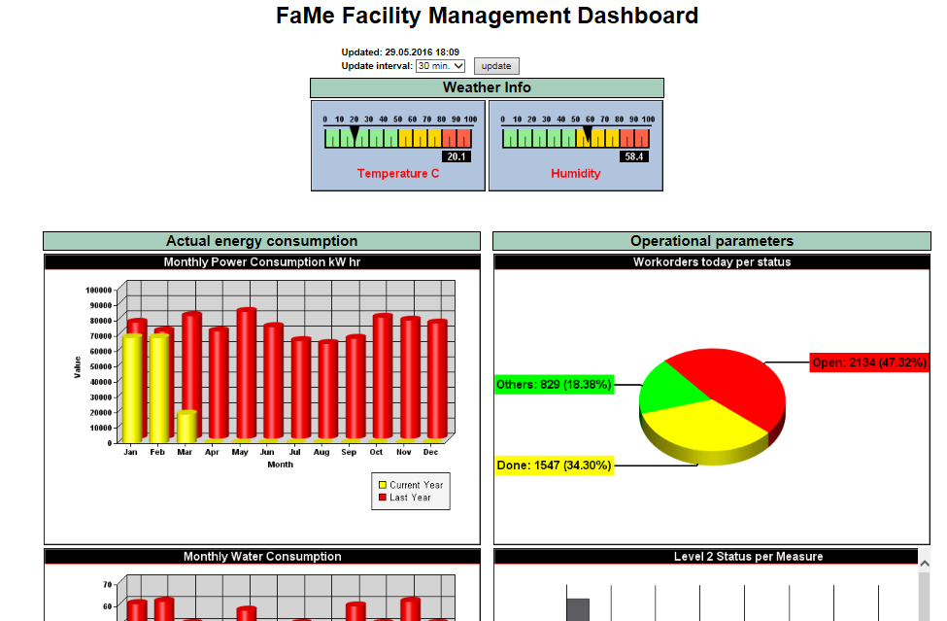
综合运行报告

Slide 36

谢谢

